Slide 1
영상 처리의 실제
Image Processing

Slide 2
Chap7 Image Transformation
introduction to frequency domain
  any periodic signal can be represented as a weighted sum of sinusoids

Slide 3
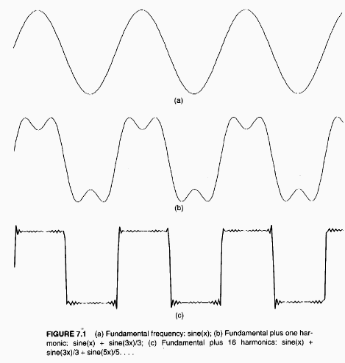

Slide 4
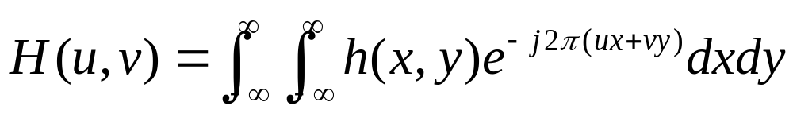
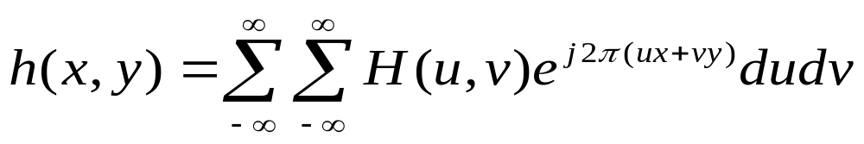
  spatial frequency of an image refers to the rate at which pixel intensities change
  Fourier transform

Slide 5
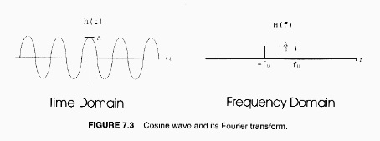
    H(u,v); u represents spatial frequency along x axis, and v represents spatial frequency along y axis of an image

Slide 6
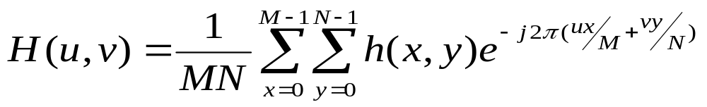
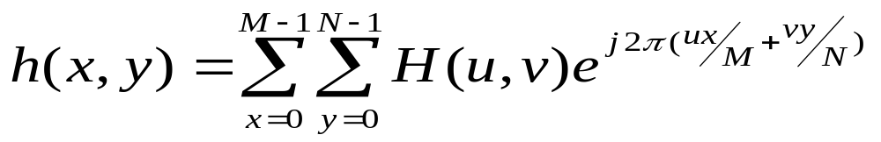
discrete Fourier transform

Slide 7
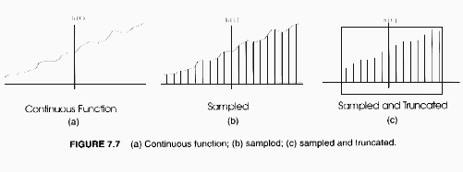
  DFT expects input to be periodic

Slide 8
  Gibbs phenomenon
    ringing effect caused by sampling & truncation
    can reduce width of ringing by increasing the number of data samples
    amplitude of ringing is proportional to difference between amplitude of first and last sample
      can reduce it by multiplying data by windowing function

Slide 9
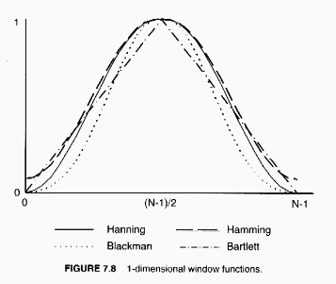

Slide 10
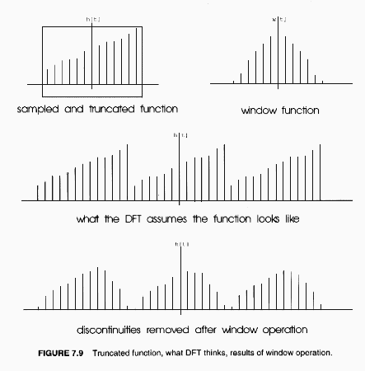
      window functions attenuate values at truncation edges

Slide 11
fast Fourier transform
  adopt divide and conquer technique for fast computation - NlogN complex multiplication
  dimension of image must be powers of 2
    expand to legal size by zero-padding

Slide 12
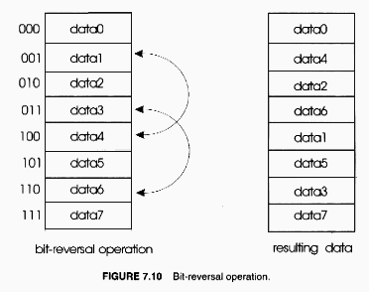
(1) bit-reversal operation

Slide 13
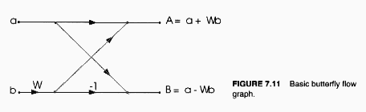
    exploit periodicity and symmetry of recursive DFT computation
    swap data elements for in-place computation
  (2) butterflies operation
    divide set of data points down and perform series of 2 points DFT

Slide 14
  how to display frequency data
    1 pixel range represents change of spatial frequency of 1 cycle per image width
    they have a wide dynamic range
      take logarithm of the spectrum
    unordered vs ordered display
filtering in the frequency domain

Slide 15
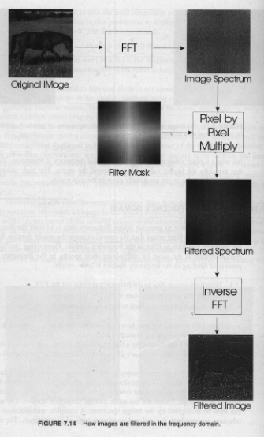

Slide 16
  convolution in spatial domain is the same as multiplication in frequency domain
  (1) transform into frequency domain by FFT
  (2) multiply by filtering mask
    center mask in the center of image and zero pad out to the edge

Slide 17
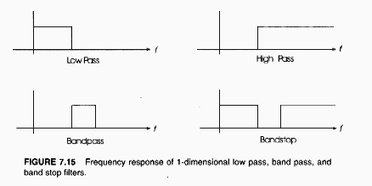
  (3) transform back to spatial domain
  low-pass, high-pass, band-pass, band-stop filtering,

Slide 18
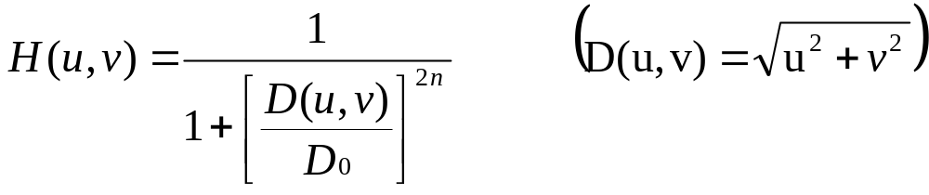
  ideal filters cause blurring & ringing in spatial domain
    use Butterworth filter for smooth frequency response

Slide 19
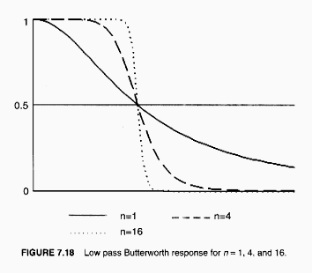

Slide 20
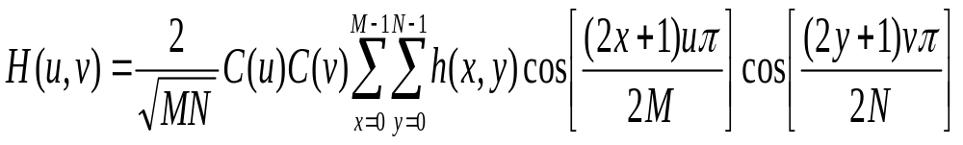
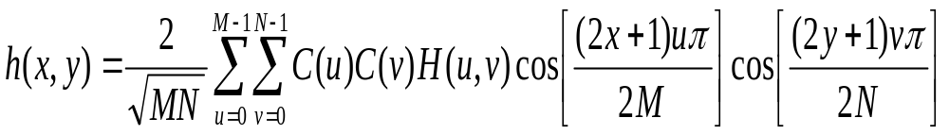
discrete cosine transform
  produce real frequency coefficients

Slide 21
Chap8 Warping & Morphing
warping
  stretch image in several different directions
  originally used by NASA to straighten images returned by satellites
morphing
  warping and cross-dissolving two images
  transition morph
    gradually transform source image to target

Slide 22
  distortion morph
    gradually transform source image by stretching or squeezing itself
spatial transformation
  break two images into grids (set of triangle or quadrilaterals) and map the grids from input to output
    require many intermediate frames for smooth transition from input to output

Slide 23
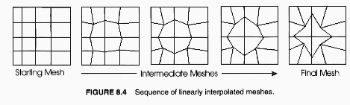
  can use affine, bilinear, or perspective transform for geometric mapping of each polygon
  use normalized coordinate system

Slide 24
affine transformation
  any combination of scales, rotations, and translations
  preserve parallel lines
  map triangles into triangles and rectangles into parallelograms
  can be specified by 3 control points
    often use a grid of triangles

Slide 25
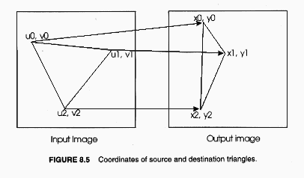

Slide 26
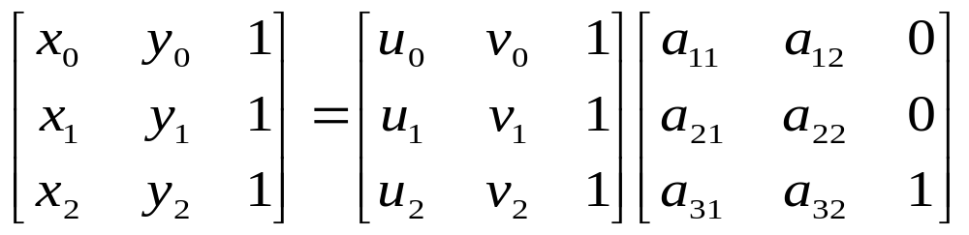
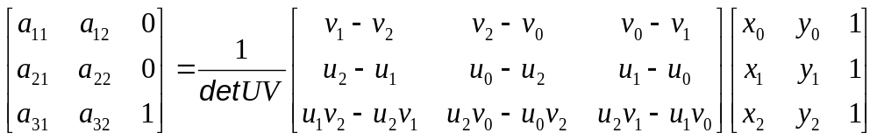
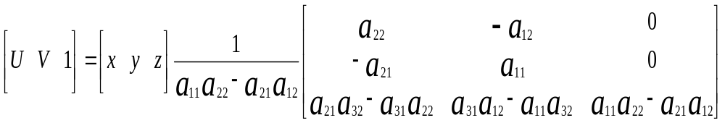
  forward and inverse mapping
  x = a₁₁u + a₂₁v + a₃₁
  y = a₁₂u + a₂₂v + a₃₂

Slide 27
perspective transformation
  preserve lines of all orientations
  square-to-quadrilateral mapping
      establish 4-point correspondences from (u,v) plane onto (x,t) plane
        (0,0) --> (x0,y0), (1,0) --> (x1,y1)
        (0,1) --> (x2,y2), (1,1) --> (x3,y3)
      get 9 coefficients, a11 through a33
      apply equations, forward and reverse mapping
  quadrilateral-to-square mapping
      compute square-to-quadrilateral mapping coefficients
      apply reverse equation of square-to-quadrilateral mapping

Slide 28
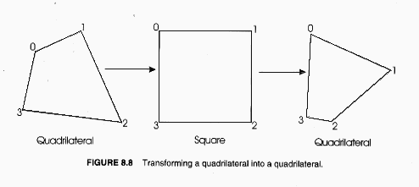
  quadrilateral-to quadrilateral mappling
    two step process

Slide 29
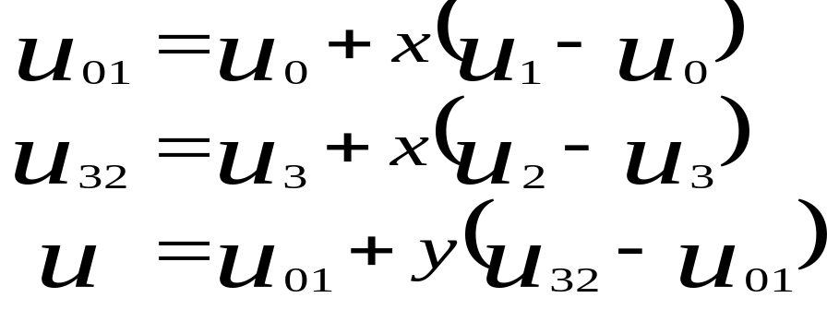
bilinear transformation
    preserve equispaced points along horizontal or vertical lines, but map diagonal lines onto quadratic curves
    reverse mapping for quadrilateral to rectangle

Slide 30
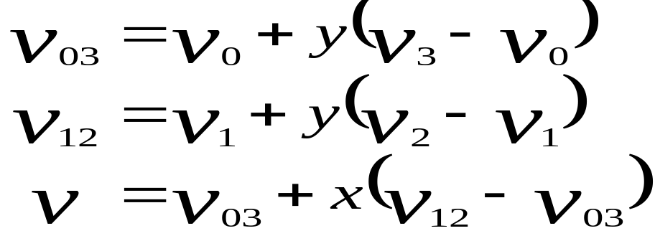
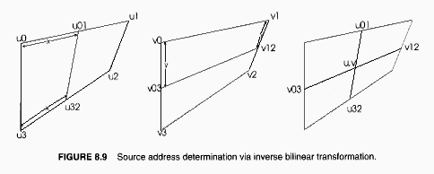

Slide 31
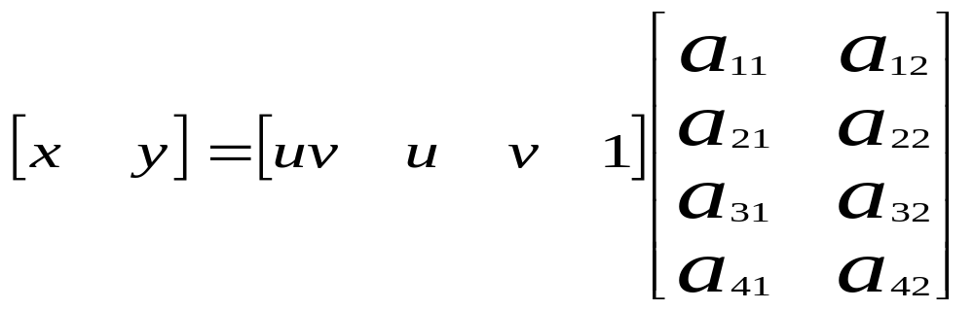
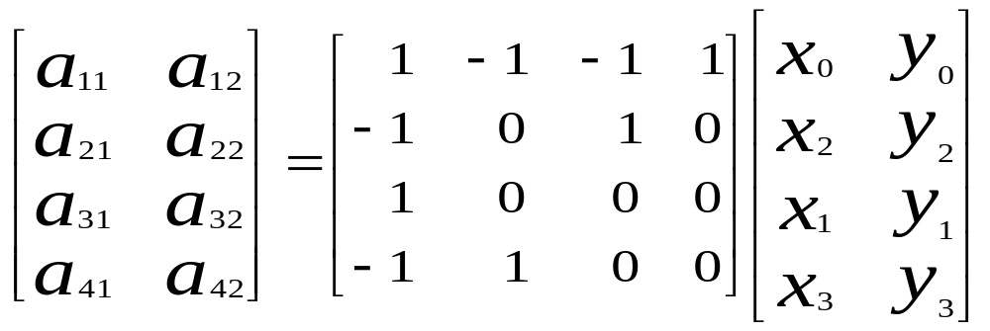
    mapping for rectangle to quadrilateral

Slide 32
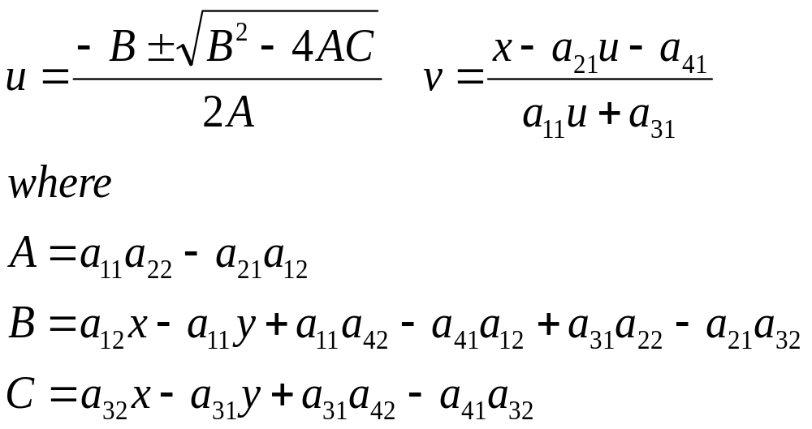

Slide 33
Fant’s resampling algorithm
    reduce aliasing artifacts by evaluating values of all input pixels when creating a output pixel
    check one of 3 conditions when treating each input pixel
      input pixel is completely consumed without generating a new output pixel
      input pixel is completely consumed and a new output pixel is generated
      output pixel is generated without entirely consuming input pixel

Slide 34
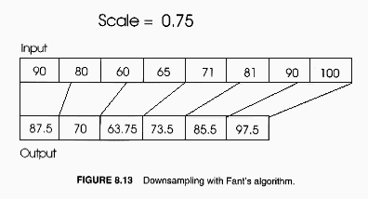
    downsampling

Slide 35
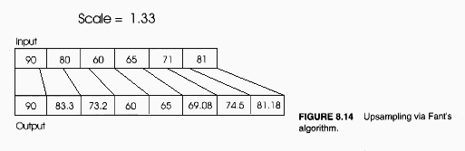
    Upsampling
    SCALE can be a variable

Slide 36
meshwarp algorithm
  2 pass algorithm; process each row in one pass and each column in second pass
  input to algorithm
      source image and destination images, Is and Id (Hin x Win), with corresponding meshes or control points, S and D (h x w)
  at each pass
    generate intermediate array of control points, I
    interpolate data points between control points resulting in Ts and Ti with Hin x w or h x Win
    resample each row or column to get Hin x Win

Slide 37
  first pass
      map each input pixel into its proper output column
    phase I
      fit vertical splines through x coordinates of each column of control points
      sample vertical splines as they cross each row, creating Ts and Ti of Hin x w
      compute scaling factor for resampling each row
        take x coordinates of source mesh as independent variable and that of intermediate mesh as dependent variables
        interpolate new values for each pixel in a row and use the new values to determine scaling factors

Slide 38
    phase II
      resample each row of source with Fant’s algorithm, resulting in intermediate image
  second pass
      operate similar steps as of phase I onto columns
      resample each column of intermediate image, resulting in final image
field-based warping
    draw control lines on source and corresponding ones on target image
    map pixels of source onto target depending on their positions to control lines

Slide 39
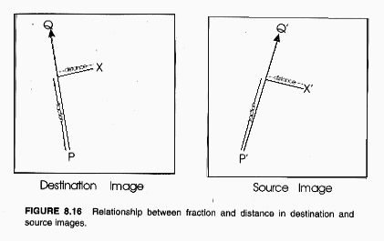

Slide 40
      when multiple lines are used, assign weights to each line, equation
    can control better than meshwarp algorithm
    can handle diagonal features
    can be very slow as the number of control lines increases

Slide 41
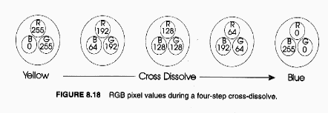
cross-dissolve
    smoothly blend each newly warped image with final image by taking weighted average
    determine weights according to morph’s completeness

Slide 42
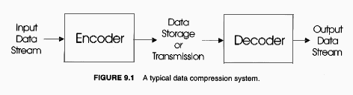
Chap9 Image compression

Slide 43
    compression ratio
    original data/compressed data
    lossless compression vs lossy compression
    terminologies
      character - fundamental data element in input stream
      string - sequence of characters
      input stream - source of uncompressed data, sometimes data file or communication medium
      codeword - data element used to represent input character or character string

Slide 44
run length encoding
  utilize repetitiveness of data - run
  how to represent a run
    by count and original data
    by prefix attached count and original data
      two types of prefix representing runs of repetitive data and strings of unique data

Slide 45
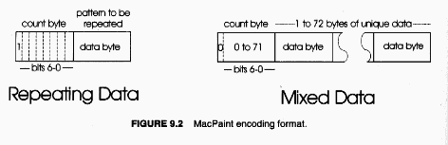
  good for images with solid backgrounds like binary cartoon images

Slide 46
Huffman coding
    variable length code whose length is inversely proportional to that character’s frequency
    must satisfy nonprefix property to be uniquely decodable
    two pass algorithm
      first pass accumulates the character frequency and generate codebook
      second pass does compression with the codebook
    create codes by constructing a binary tree
      1. consider all characters as free nodes
      2. assign two free nodes with lowest frequency to a parent nodes with weights equal to sum of their frequencies

Slide 47
      3. remove the two free nodes and add the newly created parent node to the list of free nodes
      4. repeat step2 and 3 until there is one free node left. It becomes the root of tree

Slide 48
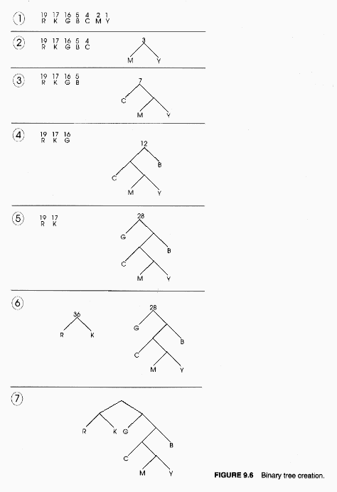

Slide 49
modified Huffman coding
    used in facsimile transmissions
    use one fixed table, and combine variable length encoding and run length encoding
    encode each line as a series of alternating runs of white and black bits
    count runs of white bits and black bits and convert the counts as a variable length bit stream

Slide 50
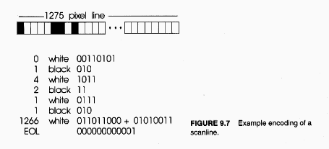
      assign terminating codes for runs of 63 or less
      assign for runs of 64 or greater makeup codes followed by special mark and terminating codes
        makeup codes are to describe runs in multiple of 64 from 64 to 2560
      assign a special code for EOL

Slide 51
modified READ
    2-dim run length coding for bilevel bitmap
    exploit transitions that begin and end each black and white run
    encode the first line of a set of K scanlines with modified Huffman and remaining lines with reference to the line above it

Slide 52
    notations
      a0:- starting changing element on the coding line
      a1:- next transition to the right of a0 on coding line
      a2:- next transition to the right of a1 on coding line
      b1:- next changing element to the right of a0 on reference line
      b2:- next transition to the right of b1 on reference line
    three different coding mode
      pass mode:- when b2 lies to the left of a1
      vertical mode:- when a1 is within 3 pixels to the left or right of b1
      horizontal mode:- when neither pass nor vertical mode
    codes for the three mode

Slide 53
      pass 0001
      vertical a1 under b1 1
      a1 1 pixel to the right of b1 011
      a1 2 pixels to the right of b1 000011
      a1 3 pixels to the right of b1 0000011
      horizontal 001+M(a0a1)+M(a1a2)

Slide 54
LZW
    encode strings of data by creating a code table
    no need to include code table with compressed data
    use 12 bit codewords, so code table has 4096 locations
      initialize first 256 locations to single characters
      parse input characters to form strings which are to be inserted into string table in locations 256-4096
    decoder creates the same string table during decompression

Slide 55
      initialize first 256 entries to single characters
      update string table for each character in coded stream, except the first one
        after codeword is expanded to its corresponding string via string table, the first char of the string is appended to the previous string and added to the table
    can compress input stream in single pass
    require no prior information about input stream
arithmetic coding
    take in complete data stream and output one specific codeword which is floating point number between 0 and 1

Slide 56
    two pass algorithm
      first pass computes characters’ frequency and constructs probability table with ranges assigned to each entry of the table
      second pass does actual compression
        first character of input stream constrains output number to its corresponding range, and the range of next character of input stream further constrains the number, and so on.
    decoding is reverse of encoding
    achieve higher compression ratio than Huffman, but computationally expensive

Slide 57
JPEG
    still-image compression standard
    has 3 lossless modes and 1 lossy mode
      sequential baseline encoding
        encode in one scan
        input & output data precision is limited to 8 bits, while quantized DCT values are restricted to 11 bits
      progressive encoding
      hierarchical encoding
      lossless encoding
    can achieve compression ratios of upto 20 to 1 without noticeable reduction in image quality

Slide 58
    work well for continuous tone images, but not good for cartoons or computer generated images
    tend to filter out high frequency data
    can specify a quality level (Q)
      with too low Q, resulting images may contain blocky, contouring and ringing structures.
    5 steps of sequential baseline encoding
      transform image to luminance/chrominance space (YCbCr)
      reduce the color components (optional)
      partition image into 8x8 pixel blocks and perform DCT on each block
      quantize resulting DCT coefficients
      variable length code the quantized coefficients

Slide 59
    step1
      separate luminance and chrominance because more information can be removed from chrominance.
      human eye tends to perceive small changes in brightness better than in color
    step2
      subsample color components by 2 horizontally and vertically
    step3
      convert elements in a tile to signed integers by subtracting one half of gray scale
      (0,0) element of DCTed block is DC and other elements are AC

Slide 60
    step4
      quantize and threshold by
        T*(u,v) = round [ T(u,v)/Z(u,v)]
        T(u,v) = transformed coefficient
        Z(u,v) = transform normalization array
        T*(u,v) = thresholded & quantized approximation of
        T(u,v)
        when Z(u,v) = c,
T*(u,v)
T(u,v)
c
2c

Slide 61
      at a receiver site, T*(u,v) must be multiplied by Z(u,v) and then inverse transformed to get approximate of subimage
        T**(u,v) = T*(u,v)xZ(u,v)
      normalization matrix is determined by quality level Q
        if Z(u,v) > 2T(u,v), then T*(u,v)=0
        transform coefficient is completely truncated or discarded
      when T*(u,v) is represented with variable length code whose length increases as |T(u,v)| increases, the number of bits is controlled by Z(u,v)
      reorder quantized coefficients using zigzag pattern to form 1-dim sequence of quantized coefficients
        zigzag pattern may result in long run of zeros

Slide 62
    step5
      DC coefficient is difference coded relative to DC coefficient of previous subimage
      AC coefficients are broken into runs of zeros ending in a nonzero number. Each broken block is to be variable length coded
      classify each coefficient into some categories based on its range
      nun length and category specifies basecode and the number of bits of a code
      determine taling bits of a code considering least significant bits of coefficient
        apply one’s complement to specify sign of the coefficient
    example, pp395-405, Digital Image Processing, R.C. Gonzalez

